Slide 1
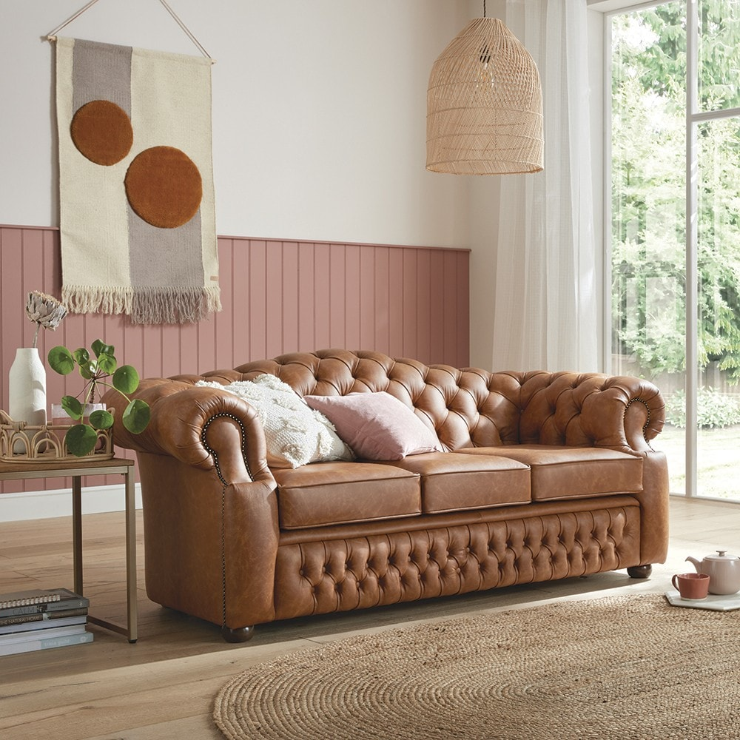

Slide 2

What Is Oxford Sofas?

Slide 3
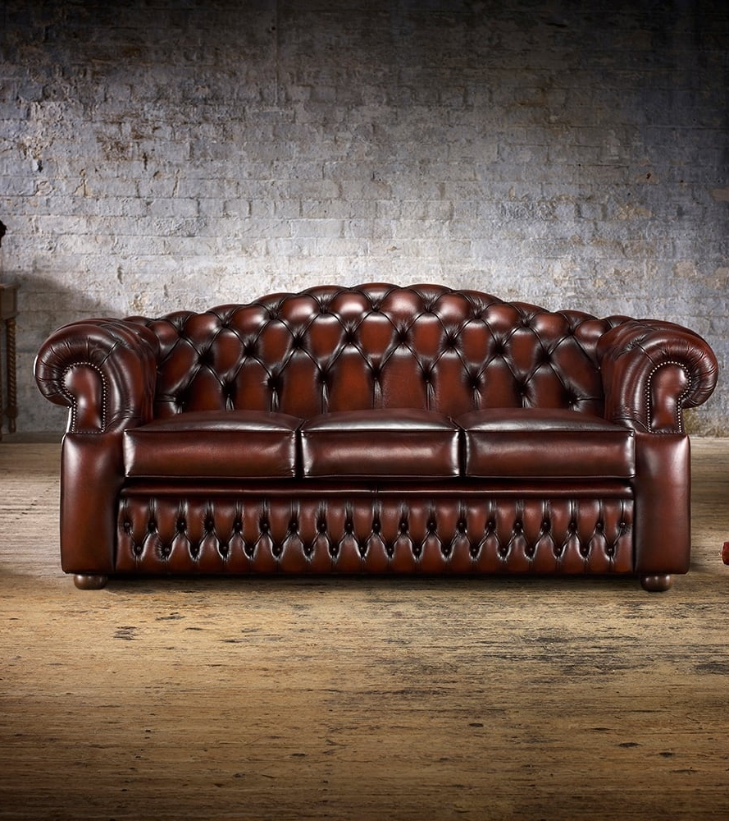

Poltrona Frau
Ligne Roset
Flexform
Natuzzi Italia

Slide 4

Poltrona Frau
Ligne Roset
Flexform
Natuzzi Italia
Poltrona Frau is renowned for luxury Italian leather furniture, handcrafted excellence, and timeless design, using premium Pelle Frau® leather and 21-step tanning. Famous for iconic pieces like the Chester armchair, it also creates bespoke interiors for luxury cars, yachts, and aviation, and public spaces like the European Parliament
Ligne Roset is famous for its innovative contemporary furniture, especially the iconic Togo sofa . A sculptural, low-profile design by Michel Ducaroy known for its wrinkled leather look and comfort and for collaborating with leading designers to create bold, artistic pieces showcased at major design events like Milan Design Week.
Flexform is famous for its high-end Italian-made modern furniture, particularly luxurious, comfortable sofas like the iconic Groundpiece designed by Antonio Citterio, and for combining timeless design, meticulous craftsmanship, and premium materials such as fine leathers, fabrics, and sustainably sourced woods.
Natuzzi Italia is renowned for luxury Italian leather sofas, timeless modern design, and superior craftsmanship, using premium materials and innovative comfort technologies. The brand emphasizes elegant, customizable furniture with Mediterranean-inspired aesthetics, all handcrafted in Italy.

Slide 5
Poltrona Frau
Ligne Roset
Flexform
Natuzzi Italia
Poltrona Frau is renowned for luxury Italian leather furniture, handcrafted excellence, and timeless design, using premium Pelle Frau® leather and 21-step tanning. Famous for iconic pieces like the Chester armchair, it also creates bespoke interiors for luxury cars, yachts, and aviation, and public spaces like the European Parliament
Ligne Roset is famous for its innovative contemporary furniture, especially the iconic Togo sofa . A sculptural, low-profile design by Michel Ducaroy known for its wrinkled leather look and comfort and for collaborating with leading designers to create bold, artistic pieces showcased at major design events like Milan Design Week.
Flexform is famous for its high-end Italian-made modern furniture, particularly luxurious, comfortable sofas like the iconic Groundpiece designed by Antonio Citterio, and for combining timeless design, meticulous craftsmanship, and premium materials such as fine leathers, fabrics, and sustainably sourced woods.
Natuzzi Italia is renowned for luxury Italian leather sofas, timeless modern design, and superior craftsmanship, using premium materials and innovative comfort technologies. The brand emphasizes elegant, customizable furniture with Mediterranean-inspired aesthetics, all handcrafted in Italy.

Slide 6
Sofas | Description
Chester One Sofa | It has a beech wood frame, hand-tied biconical springs on jute belts and goose down and foam cushions, or leather-covered wood.
Let It Be Sofa | It has a die-cast aluminum frame, interwoven elastic belt suspension, firm foam cushions, and set-back aluminum feet.
Times Lounge | It has solid ash wood frame in moka, technical textile seat spring, cushions padded with polyurethane foam and polyester wadding.
Grantorino Sofa | features are tubular metal frame, variable-density foam, pressed felt, goose down cushions, titanium-coloured aluminium feet.
Archibald Armchair | features a steel frame, moulded polyurethane foam and polyester wadding padding and elastic belt suspension.
John-John Sofa | It features a solid beech structure with a central iron crossbar, polyurethane foam and soft goose down cushions.
Claydon Sofa | Its features are light polyurethane foam padding, visible metal hinges with Ruthenium finish, and X-stitched cushions.
Cestlavie Sofa | It is a side table with a tubular aluminium structure, with handwoven Saddle straps, a folding leather top, and tone-on-tone dyeing.
Martha Armchair | moulded rigid polyurethane frame, hidden backrest fixing, triangular-section solid ash base (moka), Saddle Extra Leather exterior.
Fidelio | it is a furniture collection with solid ash and birch plywood structure, extra light natural maple interiors, and tops in marble or wood.
Happy Jack Sofa | It has a curved, wrap-around cushioning with leather-covered die-cast aluminum base, and removable fabric.
Soufflé Sofa | It Features a steel frame with elastic belt suspension, with goose down and polyurethane foam cushions, and slender metal legs.
Massimo System Sofa | beech and poplar structure, elastic belt suspension, goose down and foam cushions, three armrest heights, and black aluminum feet.
Montera Sofa | It is a seating collection with molded beech plywood shell, polyurethane foam padding with solid ash or steel legs.
Lepli Sofa | It features a birch and poplar plywood structure, polyurethane foam padding, and a black lacquered MDF base.
Sofas we Sell From Different Brands
(Poltrona Frau)

Slide 7
Sofas | Description
Togo sofa | Its Features are low-slung, modular design, deeply padded foam layers, no visible frame, and available in fabric or leather upholstery.
Ploum Sofa | It has a fully upholstered in quilted fabric. It has no visible frame, creating a soft, sculptural look, and is supported by low metal legs.
Manarola Sofa | a tubular steel shell-frame embedded in expanded polyurethane padding. It has a soft, comfortable form with a Sculptural design.
Ruche Sofa | It features a solid beech wood frame with slender legs, quilted seat cushion and It combines rigid structure with flexible comfort.
Pumpkin Sofa | soft, organic, round shapes and firm seating comfort all characterize the Pumpkin collection, also available as an armchair.
Kashima Sofa | All-foam construction with high-density Bultex foam, integrated armrests, lumbar, headrest, and fully quilted removable cover.
Prado Sofa | Modular bench seat with weighted, anti-slip back cushions; reversible seat for use as a bed.
Noka Sofa | Low, modular sofa with high arms, deep seat, ash wood shelf, and removable fabric cover.
Ottoman Sofa | It is a low, upholstered furniture piece used as a footrest, extra seat, coffee table, or storage unit, often without arms or a back.
Saparella Sofa | Modular 1965 design with concave diabolo, steel links, quilted foam, and removable cover for indoor or outdoor use.
Taru Sofa | Fully upholstered base, curved bi-material back, mixable fabrics, elastic webbing, Bultex foam, professional cover removal.
Paipai Sofa | Origami-inspired cocoon design, high-resilience Bultex foam, flexible armrests, removable fabric/leather cover, matte black steel legs.
Nomade2 Sofa | Modular steel-frame sofa with soft or firm Bultex foam, feather back cushions, and removable fabric covers.
Uncover Sofa | All-foam construction, quilted stretch cover, clean lines, high-resilience Bultex foam, removable cover, minimalist design.
Exclusif Asymmetrical | Asymmetrical design with webbed suspension, feather cushions, Bultex foam core, removable covers, and optional linking modules.
Ligne Roset

Slide 8
Sofas | Description
Ground Piece | Low, modular sofa with deep seats, down-filled cushions, and armrests that double as shelves or storage.
Feel Good Sofa | featuring a leather-covered metal frame, goose down cushions, and a timeless, elegant design
Soft Dream Sofa | Low, modular sofa with deep seats, down-filled cushions, and armrests that double as shelves or storage.
Cestone Sofa | metal frame with woven cowhide strips in a checkerboard pattern, goose-down filled cushions, removable fabric or leather covers
Lario Sofa | a slim 88 cm depth, padded block design, relaxing mechanism, optional storage armrest, and cowhide roll for head support.
Gregory Sofa | a metal base with cowhide webbing, cast aluminum feet, and removable fabric or leather upholstery in modular configurations.
Campiello sofa | a metal base with cowhide webbing, cast aluminum feet, and removable fabric or leather covers in modular designs.
Super MAX Sofa | kidney-bean seat, cylindrical backrest, tubular metal frame, and is designed for social spaces like offices and lounges.
Guscio Sofa | enveloping polyurethane shell, goose-down seat cushions, non-removable fabric or leather upholstery, and a base in solid wood.
Super Max Sofa | lowered tubular metal frame, generous kidney-bean shaped seat with enhanced padding, and a cylindrical backrest.
Perry up Sofa | a plywood and metal structure, variable-density foam,, removable upholstery, with tubular metal base with aluminum feet.
Lounge Scape Sofa | monocoque structure, organic shapes, raked base for lightness, and removable fabric or leather upholstery.
Asolo Sofa | lightweight metal base, deep seating, removable fabric or leather covers, and a minimalist, modular design for modern living.
Edmond Sofa | a tubular metal frame, crushproof backrest insert, and removable fabric or leather upholstery in modular designs.
Adda Sofa | a low, modular design with deep seating, goose-down cushions, a tubular metal base, and removable fabric or leather upholstery.
Flexform

Slide 9
Sofas | Description
Revive Recliner Sofa | Responsive Recline, dynamic arms, 360° swivel, tilting ottoman, , adapting fluidly to body movements with 120 precision components.
Diesis Sofa | a compact, linear design with adjustable headrests, Soft Touch recline mechanism, and wooden feet.
Melpot Modular Sofa | extreme modularity, combining seating, ottomans, and bookshelves, with fabric or leather covers, including quilted options.
Philo Sofa | refined quilting, metal feet, soft padding, recline function, Soft Touch mechanism, with ZeroWall technology,
Re-Vive Recliner | Recline, dynamic arms, 360° swivel, tilting ottoman, Flex Back, and is crafted with Italian leather and 120 precision components.
Dorain Sofa | Memory Foam, hidden anti-slip feet, and high modularity with all-around trimmed modules for versatile configurations.
Melpot Sofa | an extremely modular system with interchangeable elements, featuring Climalight seat cushions, and optional shelves or drawers.
Plaza Sofa | It has a metal base, soft leather upholstery, and a comfortable seat with Memory Foam and goose down padding.
Brio Recliner | Soft Touch recline, electric headrests, memory foam cushions, zero-wall mechanism, and built-in Bluetooth audio system in a sleek.
Icon Sofa | a soft, rounded modular design, Climalight and polyurethane padding, vertical quilting on leather, and a black chrome-metal base.
Felix Sofa | a linear, minimalist design with soft leather upholstery, hidden feet, Climalight seat cushions, and a comfortable, enveloping shape.
Natuzzi Adagio | a sleek, modern design with soft leather upholstery, a low profile, and a comfortable seat with Memory Foam and goose down padding.
Lemiere Sofa | a refined, contemporary design with soft leather upholstery, a metal base, Climalight seat cushions, goose down back cushions.
Domus Project | modular sofa system with recliner options, zero-gravity function, integrated storage tables, and dual power motion.
Duca | wide armrests with storage, adjustable headrest, Soft Touch recline, Zerowall system, and optional audio kit with Bluetooth connectivity.
Natuzzi Itatia

Slide 10

Made By:
Muhammad Aaliyaan
Junaid Arif
Syed Wasil
Mesam

